Slide 1
Ghidra-LLM: Large Language Models for Static Reverse Engineering
Spring Week 2 Update
Project 9: Bisesh, Mack, Maximilan, Craig, Justin

Slide 2
Review - Project Goal
In this project, our team will create large language model support for NSA’s new reverse engineering tool, Ghidra.
Reverse engineering is inherently a lossy process. Valuable context and data is often lost or obscured. Our goal is to use machine learning to bridge this gap.

Slide 3
Review – Project Process
Multi-step project that consists of numerous phases
Phase 1: Research & Red Teaming current LLM application (Fall 2024)
Phase 2: Improving current models (Late Fall 2024 – Early Spring 2025)
Phase 3: Further refinement & integrating our new model into Ghidra and Documentation (Spring 2025)

Slide 4
Review – Phase 1 Research & Red Teaming current LLM application (Fall 2024)
We are taking advantage of a current existing open-source large language model "LLM4Decompile".
This LLM already has the ability to decompile binary/assembly to C (Best version ~65% accurate)
Our current goal is to refine this LLM to become more accurate.
How do we accomplish this?

Slide 5
Review – Phase 2 Improving current models (Late Fall 2024 – Early Spring 2025)
Build the RAG Pipeline
Build the DataBase for the Pipeline
Expand on the Red Teaming efforts and put all Hallucinations into buckets
Finetune everything

Slide 6
Review – Phase 3 Further refinement & integrating our new model into Ghidra and Documentation (Spring 2025)
Documentation, Documentation, Documentation
RAG Pipeline Refinement

Slide 7
Team Objectives
Our team has the latest LLM4Decompile model running on our development environment
Hosting this model on ubuntu desktop provided by GMU, with code repository (github) https://github.com/SPIRE-GMU/SPIRE_GLLeN/tree/dev
With the model running, we can begin to test, improve, and refine it.
We have split into 2 teams to achieve these objectives
RAG Team – This team oversees building a RAG Pipeline that we will combine with LLM4Decompile to improve accuracy
Red Team – This team oversees evaluating the current LLM4Decompile model and determining where it falls short.

Slide 8
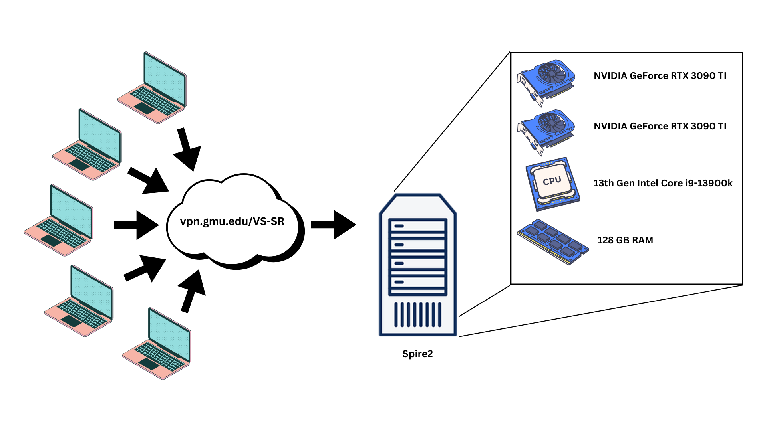
Lab Environment

Slide 9
Transition Period (Spring – Fall semesters)
Before End of Semester
Initial metrics to quantify our hypothesis
Optimizing and Finetuning
Winter Break
Finalize RAG pipeline integration with all data types
Beginning of Spring
Begin large scale metrics collection
Begin writing report for ACM CCS 2025

Slide 10
Red Team (Mack, Max, Bisesh) Objectives – Last Semester
Learned about Red Teaming LLMs
Performed Red Teaming efforts on model
Began basic refinement of model with most obvious flaws

Slide 11
Red Team (Mack, Max, Bisesh) Objectives – Next 2 weeks
Finalize hallucination bucket sort (Determine largest hallucination errors)
Begin write up on most common hallucinations

Slide 12
RAG Team (Craig, Justin) Objectives – Last Semester
Learned about Ghidra
Learned about LLM4Decompile
Learned about RAG
Began Building RAG Pipline
Built database for RAG Pipline

Slide 13
RAG Team (Craig, Justin) Objectives – Next 2 Weeks
Work towards taking an assembly file and getting a CFG from it
Work on Comparison/Similarity search's
K-Nearest Neighbors

Slide 14
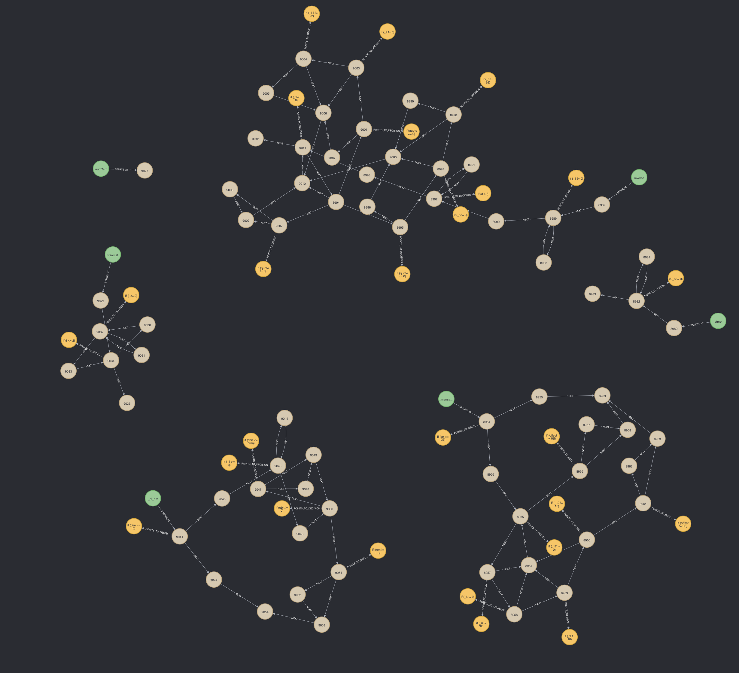
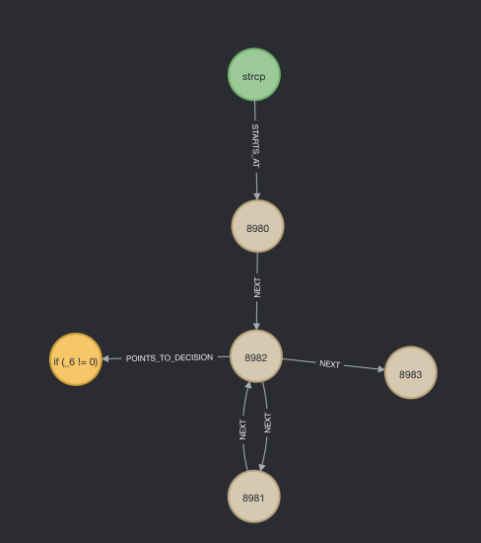
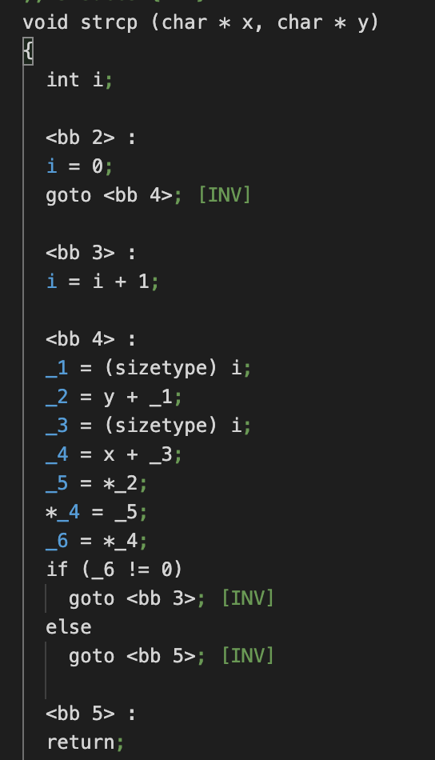
CFG Map

Slide 15
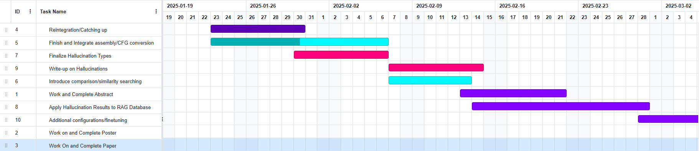
Gantt Chart – Phase 2

